Slide 1
RF Direction Detection Team R
Sylvie Sorese, Ryan Clayton, Dalton Mitchum, Robert Kramer & Krishna Patel

Slide 2
Goal
The design of an affordable system that detects the direction of arrival of a radio frequency (RF) propagating wave, in the ISM band, with the intention of eventually being used in a classroom setting.

Slide 3
Definitions, Acronyms, and Abbreviations
Radio frequency (RF)
Industrial, Scientific, and Medical (ISM)
Direction of Arrival (DoA)
Low-noise Amplifier (LNA)
Software Defined Radio (SDR)
Embry-Riddle Aeronautical University (ERAU)
Institute of Electrical and Electronics Engineers (IEEE)
Antennas and Propagation Society (AP-S)
Continuous Time (CT)
Single Pole Double Throw Switch ( SPDT)
Single Pole Four Throw Switch (SP4T)

Slide 4
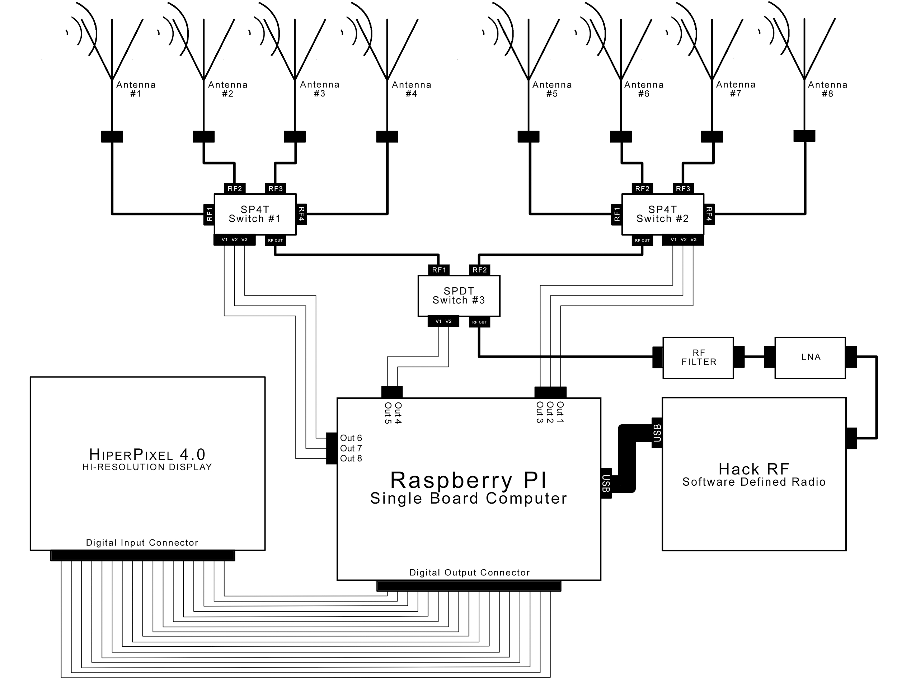
Schematic of System

Slide 5
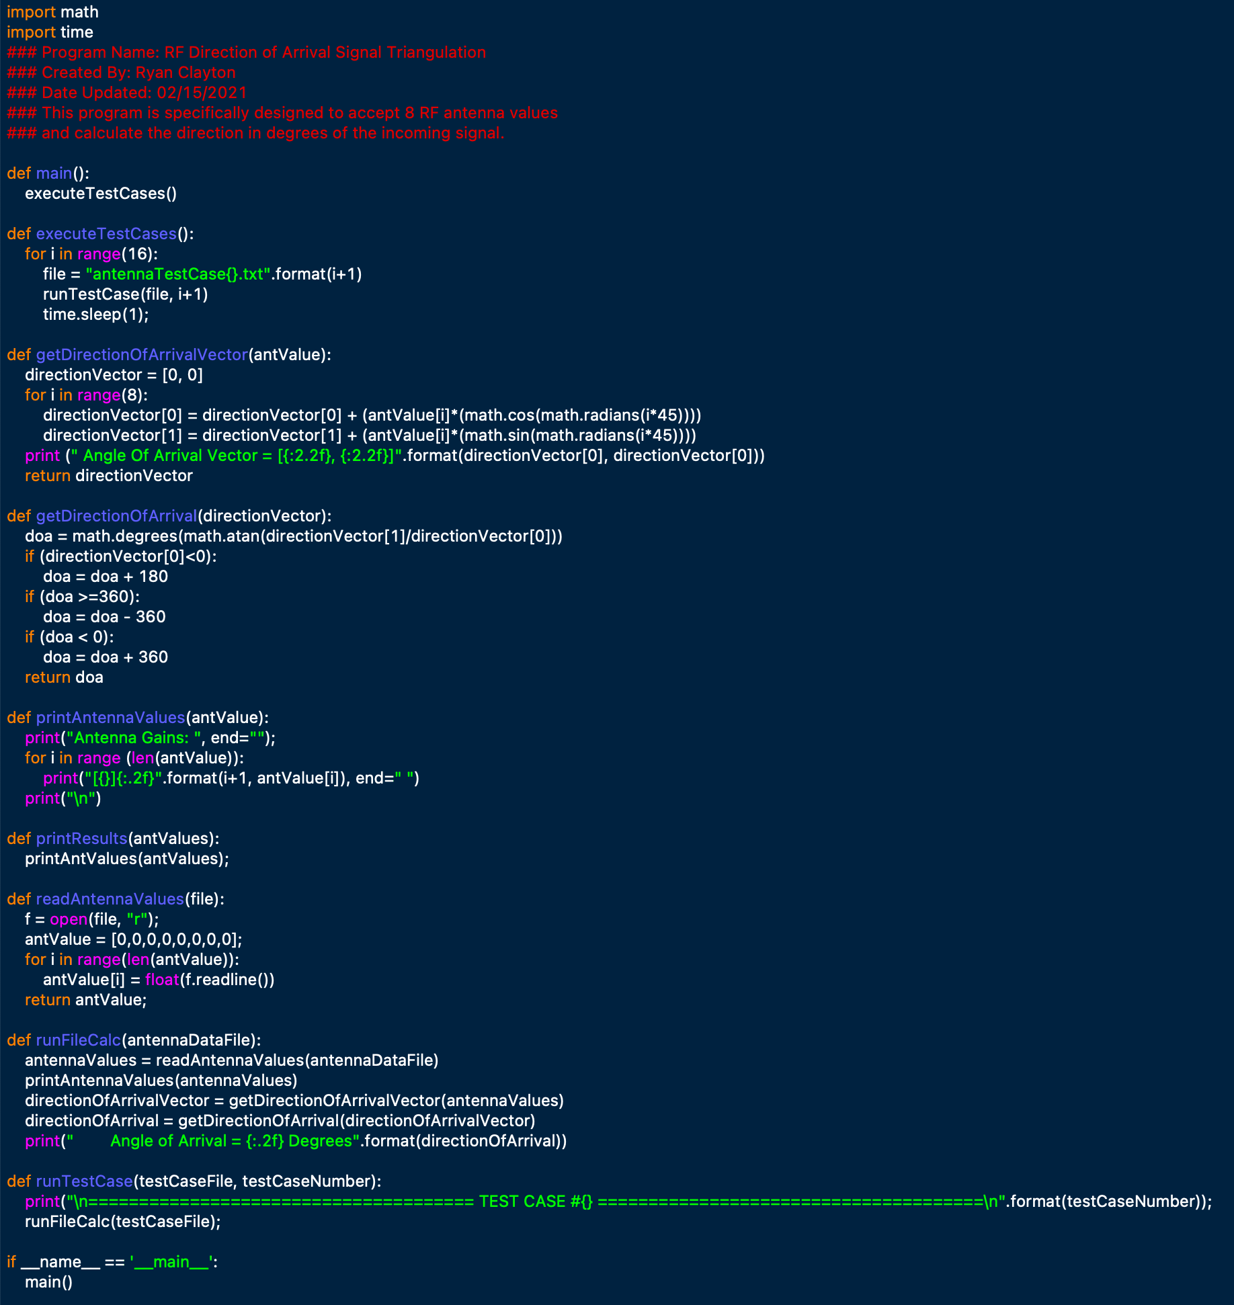
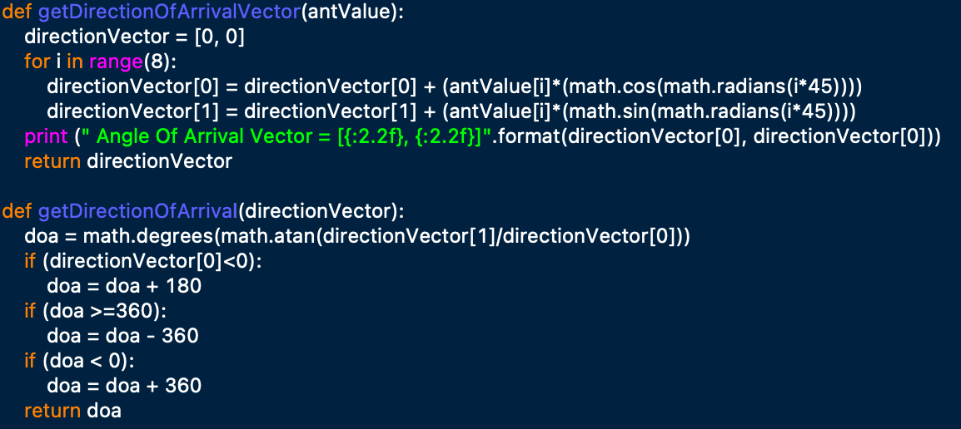
Direction Calculation Software
Utilizing Vector Analysis and treating each antenna gain as its own vector.
This gives us a very sensitive method of calculating the angle of arrival.

Slide 6
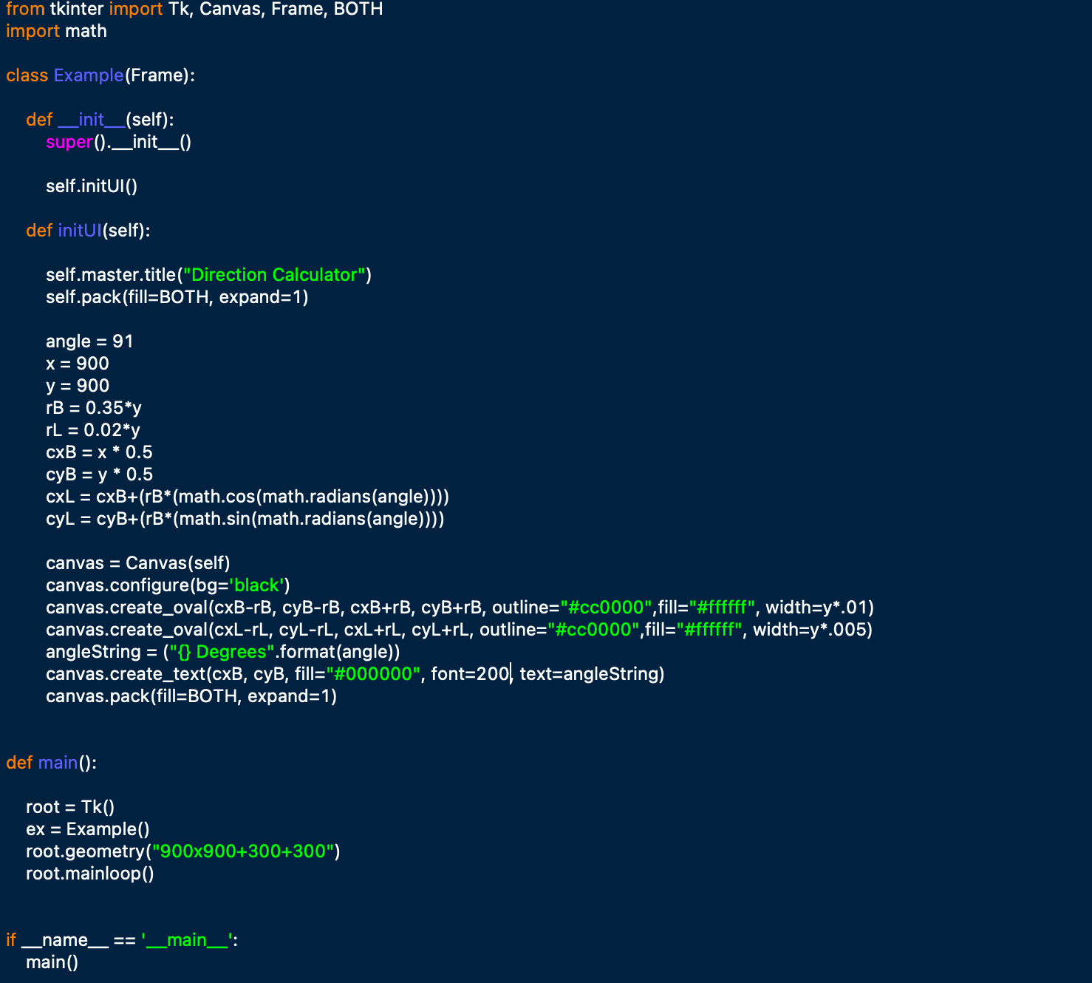
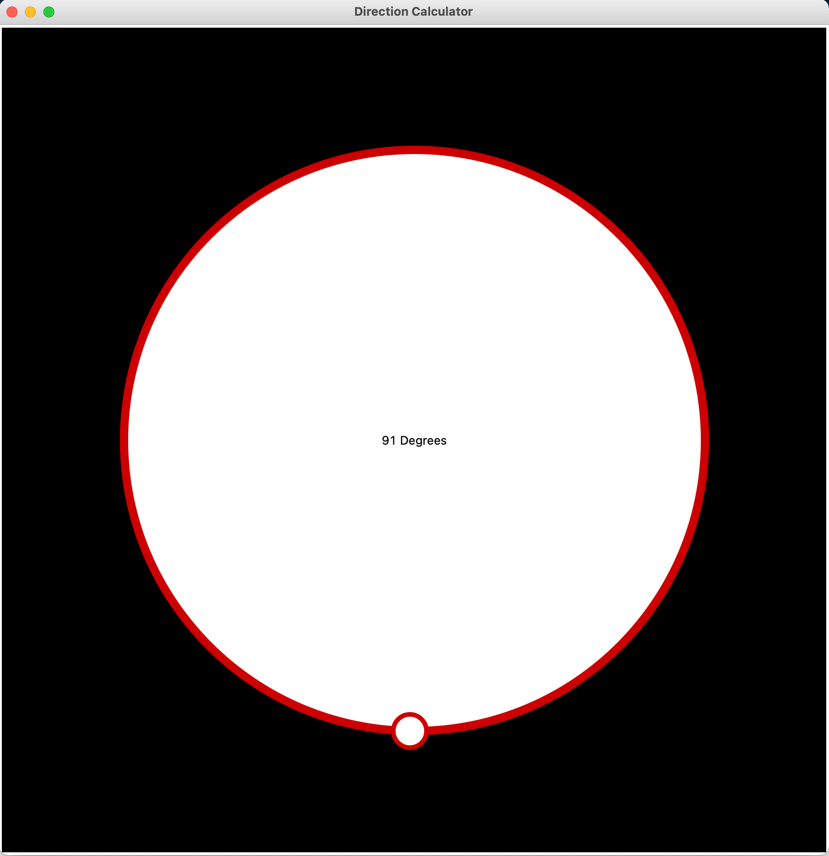
Direction Calculation Software Cont
Once system locate the direction of arrival a visual component will be utilized.
Eventually the code will run on the board doing real time calculation refreshing at a rate the choose.
The GUI shown to the right is a rough draft implementation of what will be displayed to the user.

Slide 7
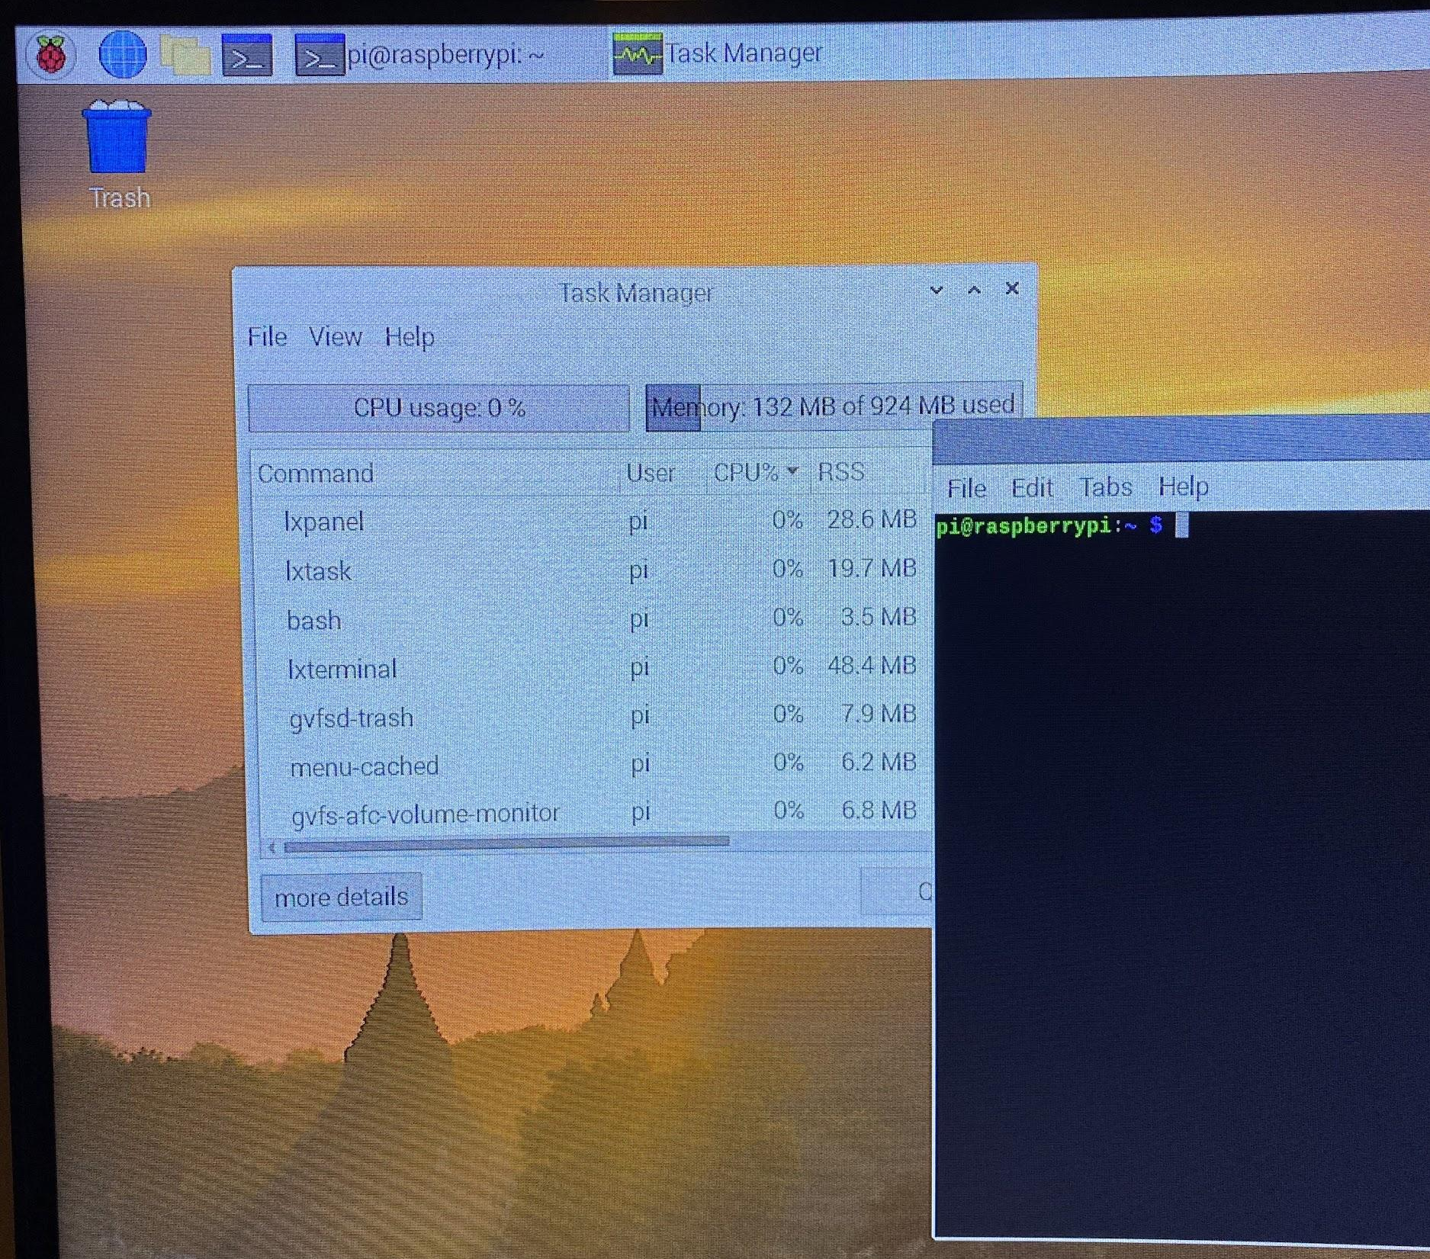
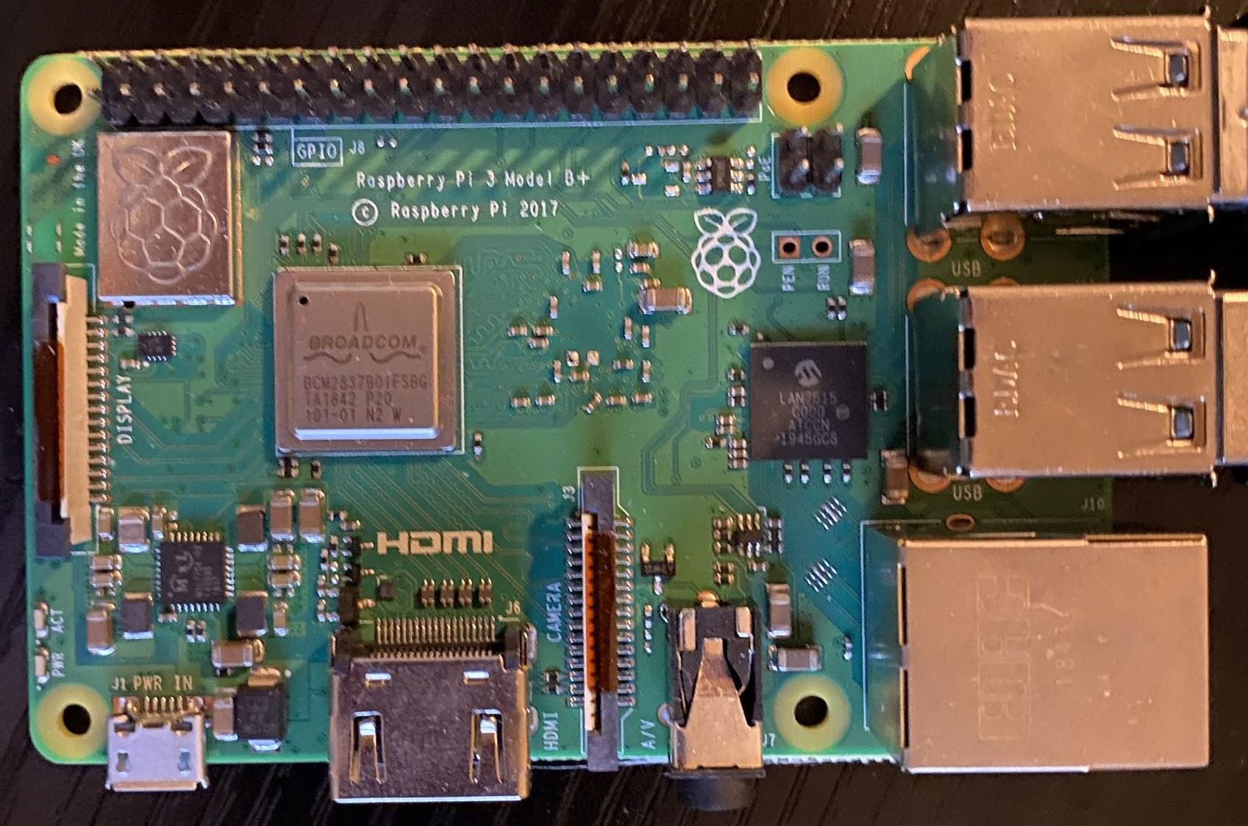
Raspberry Pi
Mini-computer
Raspberry OS installed on microSD chip
Connects to separate keyboard, monitor, and mouse
Allows for programmable control of antennas

Slide 8
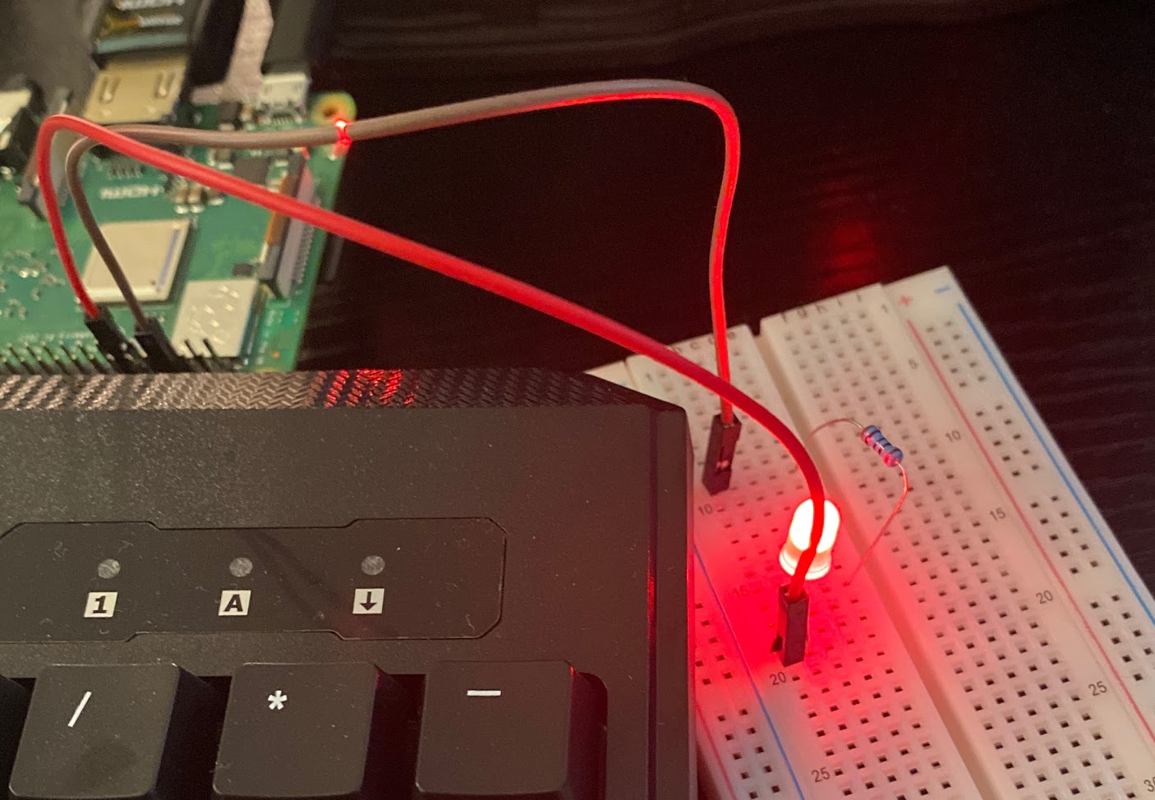
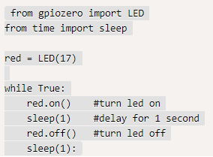
GPIO Control
Use the GPIO pins to control antenna switches
LED is proof of concept
Switches just need power like LEDs
Will cycle through each antenna so they collect data individually

Slide 9
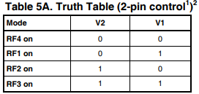
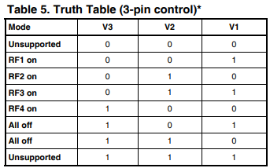
Antenna Switch Truth Tables
Will provide power to GPIO pins in relation to these truth tables
8 pins total (3 for switch 1, 3 for switch 2, 2 for switch 3

Slide 10
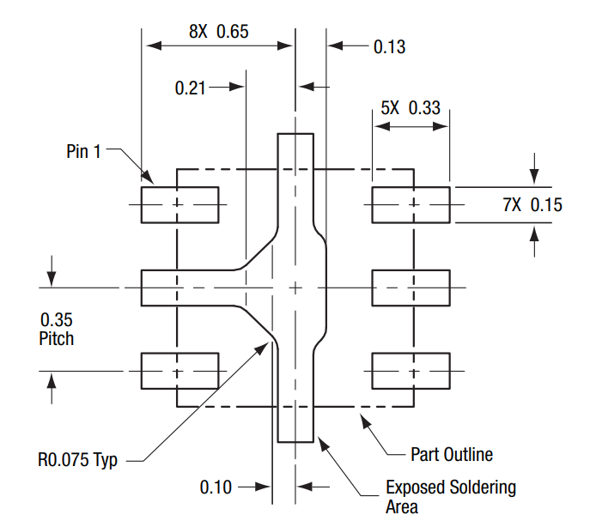
SPDT Switch Footprint
Footprint used to model SPDT switch for PCB layout design
Purpose is to be able to create PCB layout using ADS

Slide 11
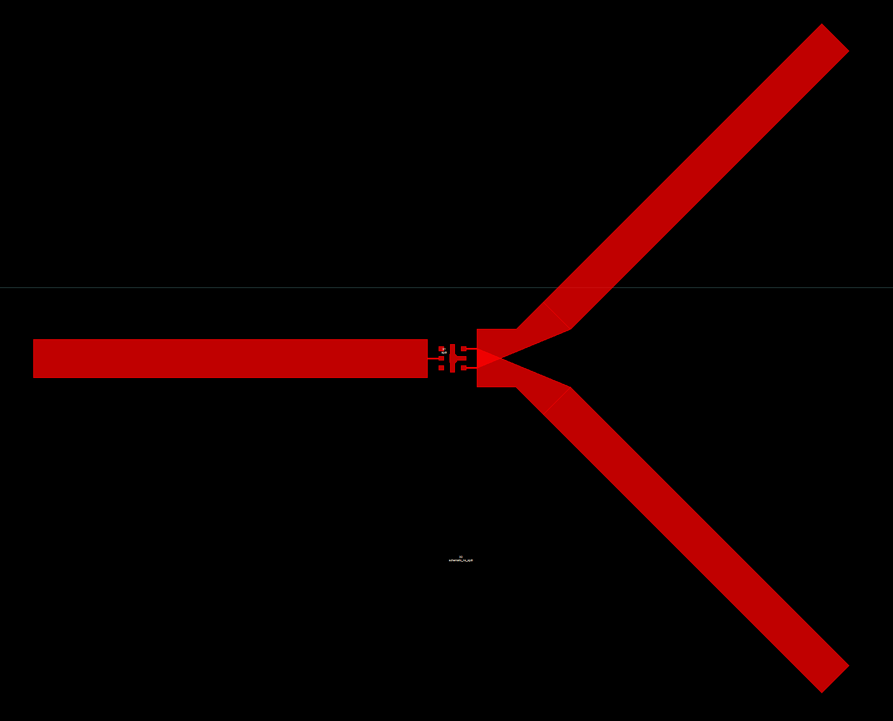
SPDT Switch PCB Layout
Transmission line design for PCB board of SPDT switch
All lengths and widths of switch are to scale
Minor overlap for transmission lines - need to adjust scaling

Slide 12
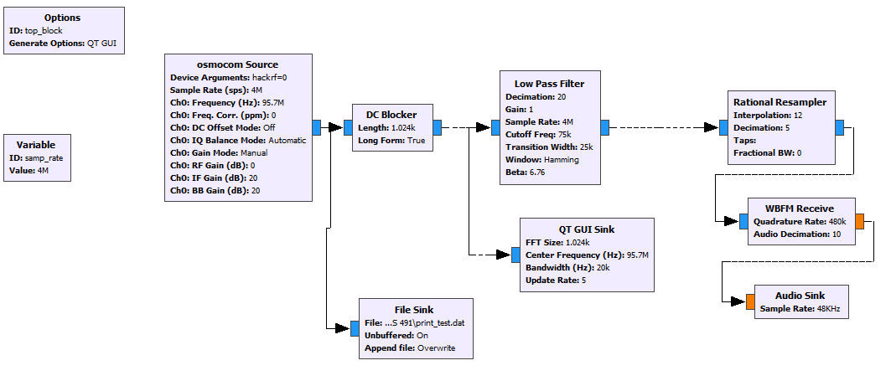
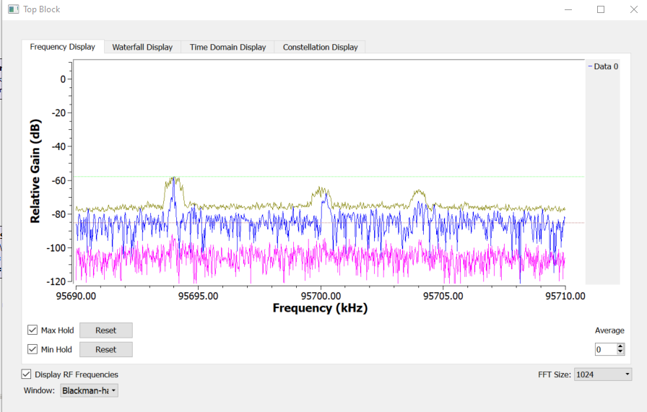
GNU Radio/HackRF One
Utilizing GNU Radio to display and record the signals from the HackRf One.
GUI shows the signal in real time and file_sink block records the real-time data.

Slide 13
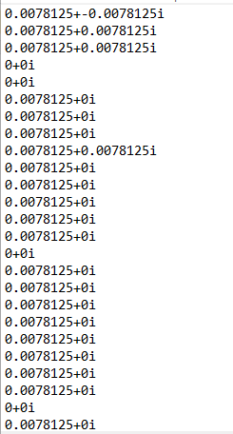
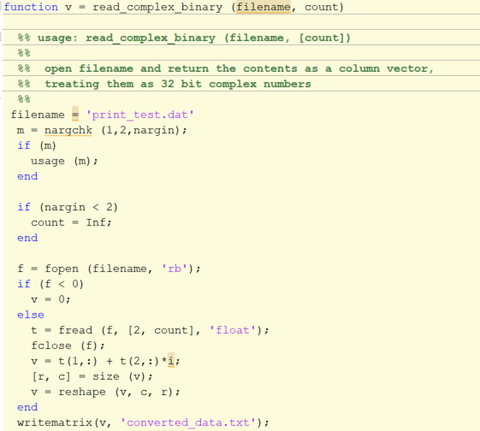
Data Conversion
The data recorded from GNU Radio is in a binary format.
Matlab is utilized to convert the binary to real complex numbers.

Slide 14
GNU Radio on Linux
GNU Radio was setup on Linux
Sources are missing
Switched Over to Windows to assist Krishna

Slide 15
Completed Backlog Items
Select a Language to code the Angle of Arrival Calculation
Develop and test .txt file reading with antenna values
Successfully Triangulate Test Cases

Slide 16
Sprint 2 Preview
Condense data recorded in GNU radio
Develop GUI for visual component of the system
Print SPDT PCB
Test SPDT PCB
Finish circuit layout design for the SP4T switches
Program GPIO pins to antenna switches
Get Raspberry Pi fully operational and prepare to run code

